Slide 1
The Argument from Evil and Other Challenges to God’s Existence
Introduction to Philosophy
Philosophy 100
Class 4

Slide 2
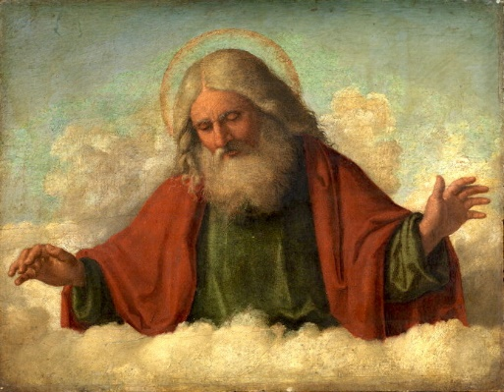
Review: God’s Characteristics
In the three main mono theistic religions, God is said to have the following characteristics:
Omnipotent – All Powerful
Omniscient – All Knowing
Omnibenevolent – All Good
Creator of the world

Slide 3
Overview
Three logical challenges to the traditional conception of God.
The Logical Argument from Evil
The empirical basis for the challenge from evil.
Theodicies
The Evidential Problem of Evil
Skeptical Theism

Slide 4

Three Logical Puzzles for Theists
If God is omnipotent, he can do anything. So can God create a stone so heavy that s/he can’t move it?
If God is omnipotent and perfect, can God ever do anything immoral?
If God is omniscient and omnipotent, God already knows what s/he will do in the future. So can God do something different in the future?

Slide 5
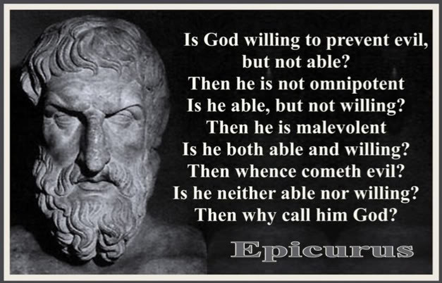
The Logical Problem of Evil & Suffering
If God exists, then God is omnipotent, omniscient, and morally perfect.
If God is omnipotent, then God has the power to eliminate all evil.
If God is omniscient, then God knows when evil exists.
If God is morally perfect, then God has the desire to eliminate all evil.
Evil exists.
If evil exists and God exists, then either God doesn’t have the power to eliminate all evil, or doesn’t know when evil exists, or doesn’t have the desire to eliminate all evil.
Therefore, God doesn’t exist.

Slide 6
Hume’s assessment of the Problem of Evil Argument
“Let us allow that if the goodness of the Deity …could be established on any tolerable reasons a priori, these phenomena [suffering], however untoward, would not be sufficient to subvert that principle, but might easily, in some unknown manner, be reconcilable to it. But let us still assert that, as goodness is not antecedently established but must be inferred from the phenomena, there can be no grounds for such an inference while there are so many ills in the universe and while these ills might so easily have been remedied, as far as human understanding can be allowed to judge on such a subject….” (Dialogues, Part XI)

Slide 7
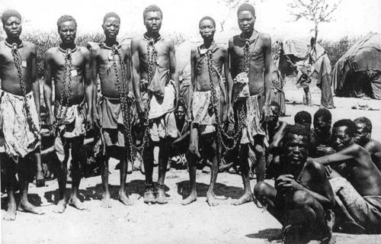
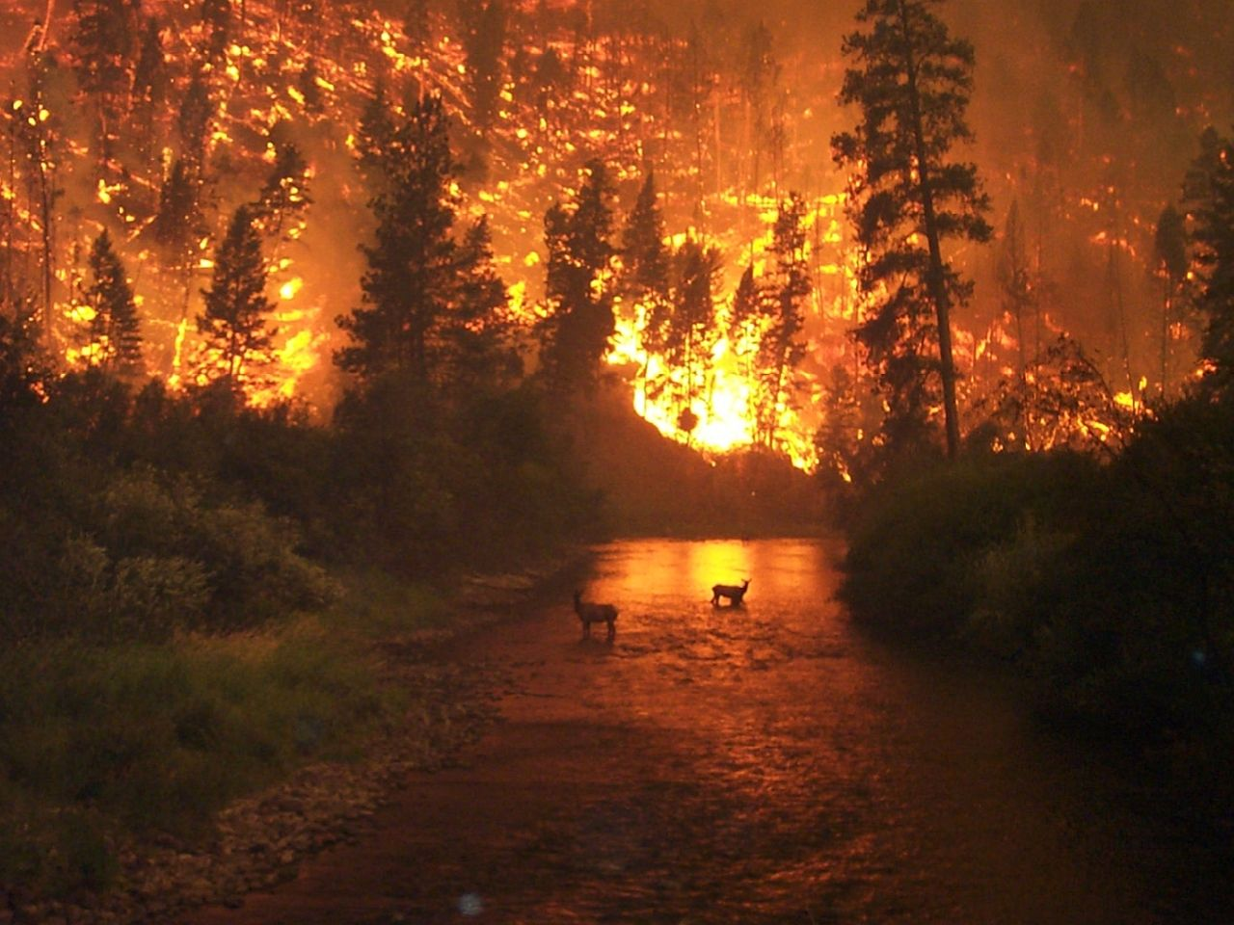
Types of Evil and Suffering
Moral Evil
Natural Evil
Moral evil includes “all evil caused deliberately by human beings doing what they ought not to do. And also the evil constituted by such deliberate actions or negligent failure.”
Natural Evil – pain and suffering caused from natural event, with no human agency or negligence as the cause involved.

Slide 8
Three Poor Responses
Suffering isn’t real.
This equivocates on what we mean by suffering.
Evil is the privation of good.
This response doesn’t, in fact, address the problem. It’s a variation on the “you can’t have good without evil,” idea. But that doesn’t explain why God allows for so much evil or such a high degree of evil.
God’s goodness is beyond human understanding—it’s divine, so our moral and ethical terms are unable to capture divine goodness.
Two problems with this response: it commits the fallacy of appeal to ignorance and it again equivocates on what we mean by goodness.

Slide 9
A Fourth Poor Response: Redefining God
Some theists have responded to the Problem of Evil Argument by changing the definition of God.
A. One idea is to deny that God is omnipotent
So He was not able to stop the 2010 earthquake in Haiti, the 2004 Indian Ocean tsunami (which killed over 250,000 people), or the Nazi Holocaust
C. “Dualism” theologies like Manicheanism, Zoroastrianism and some Christian sects, attribute suffering to an evil agent (Satan), who God cannot now control or overpower
D. Though the Problem of Evil Argument poses no challenge to these “Dualist” theologies, it is important keep in mind that Dualist theologies do not think the Basic God exists
If you adopt a “Dualist” definition of God, you are a Basic God atheist.

Slide 10
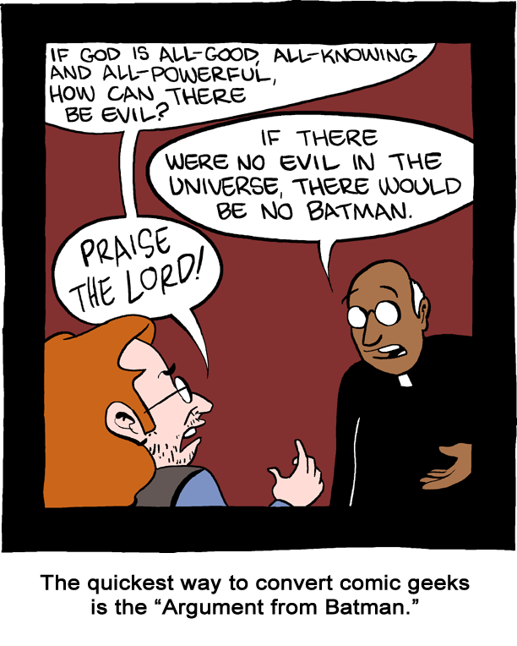
Theodicy: Why God allows Evil and Suffering
A Theodicy is an explanation for why God allows for evil and suffering.
Essentially a theodicy is a response to the problem of evil.

Slide 11
Theodicy:
We must first ask: What kind of good would a theistic God provide?
Deep goods, not merely thrills and pleasures.
Significant freedom and responsibility
for ourselves
for others
for the world in which they live
Valuable lives
being of significant use to ourselves
being of significant use to each other

Slide 12

Why moral evil?
We need freewill to achieve those deep goods that a theistic God would want for us.
Allowing us freewill logically requires that we can choose and be tempted to do wrong. If we were never tempted to do bad, we wouldn’t be significantly free.
We need to be able to form our own lives and characters. (A high good)
Lives with significant freedom are more valuable than lives without freedom

Slide 13

Why natural evil?
A world that is uniform according to laws of nature is the best way for people to recognize the consequences of their actions.
This type of world requires evil because if God were to intervene all the time to prevent the evil, the laws would cease to be laws.
A world with natural evil creates the range of choices for those within it.

Slide 14
A General Theodicy
God cannot – logically cannot – give us the goods of significant freedom, responsibility and usefulness without thereby allowing for the possibility of lots of moral and natural evil. This is why he has allowed the evil in our world to occur.
God is the creator. We’re in no position to know what’s best for us. Just as a parent sometimes has to allow a child suffer for its own good, God allows us to suffer for our own good.

Slide 15
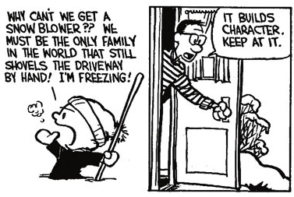
Challenges to the Character-Building Theodicy
Lots of suffering does not build character
Babies who starve to death or die of painful cancer do not develop good character traits.
An omnipotent God could provide people with good character in much less painful ways

Slide 16
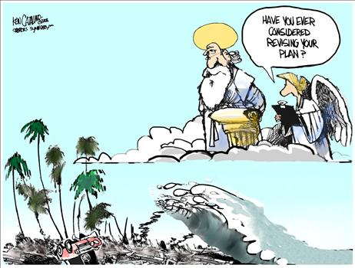
Challenges to the Freewill Theodicy
God could have given us free choice but set up the system such that we never did the bad thing.
Why so much evil and suffering? If there is even one superfluous gratuitous case of suffering, then the problem of evil still applies. Would one less (insert horrible thing here) in the world really matter to my freedom?

Slide 17
Skeptical Theism
We should not expect to be able to understand God’s reasons for allowing suffering.
The analogy with a child (or a pet)
Your dog is simply incapable of understanding why you take him to the vet
We, like dogs or little children, are not capable of understanding God’s reasons
We have very limited understanding of the pattern of cause & effect in history
So perhaps the 2010 earthquake in Haiti, or the holocaust, had (or will have) very good consequences that we cannot understand
We have limited understanding of what is really morally important or valuable
So perhaps we don’t understand the value of the suffering caused by cancer, tsunamis, etc. etc.

Slide 18
Reply to the Skeptical Theist
If we are THAT ignorant about value, cause and effect, we have no idea how to act.
We don’t know whether to help sick children or to torture them!
If skeptical theism is true, it leads to moral paralysis

Slide 19


